Slide 1
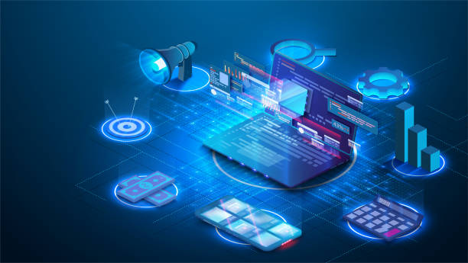
admin>node .
admin>
THE
FUTURE
OF
WEB
DEVELOPMENT
admin>node .
admin>
ENGLISH
UNIVERSITY
PRACTICAL
admin>node .
admin>
Kunal Keshan
RA2011004010051
ECE A

Slide 2
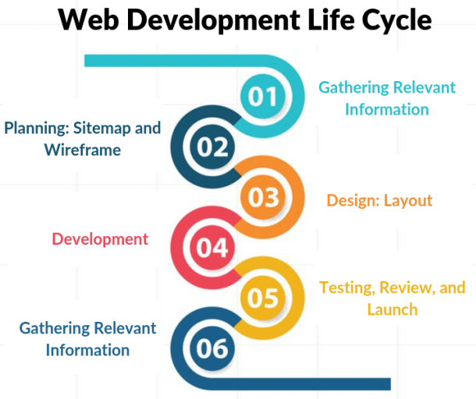
admin>node .
admin>
What is Web Development?
It is the building, testing, and maintenance of websites. It’s the work that happens behind the scenes to make a website look great, work fast and perform well with a seamless user experience.
It involves “Web Developers” who should be proficient in various languages, frameworks and libraries.
The language that a developer works on determines the type of task they perform on which they are working on.

Slide 3
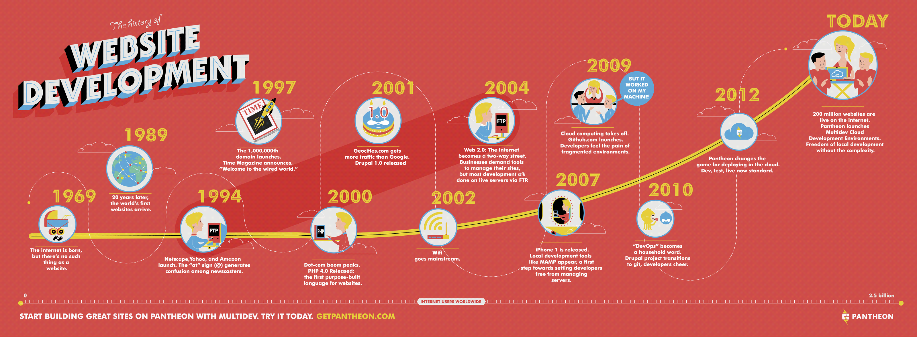
admin>node .
admin>
What is Web Development?
Since the conception of Web in 1989, the technologies revolving around it have exponentially developed at a mind boggling pace.
Today, internet connects everyone, and websites are a major medium of communication of how one works around the world.

Slide 4


admin>node .
admin>
Why Web Development?
Web Development is a very versatile field.
It involves a lot of activities and tasks that needs to be performed before bringing something to a production level.
That is what makes a developer unique, a “dev” has the ability to do multiple things that allow them to stand out in a field of career opportunities.

Slide 5

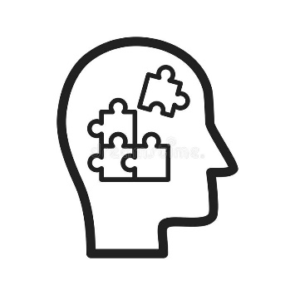

admin>node .
admin>
admin>node .
admin>
Why Web Development?
Web Dev is quite a fun activity that can be challenging, bring out one creativity and help them think for solution for problems that would be experienced from the user perspective.
Despite being demanding, web devs have the added advantage of allowing one to start a project, design it, and make the minute of changes up to their own specifications. You get to work for yourself.

Slide 6
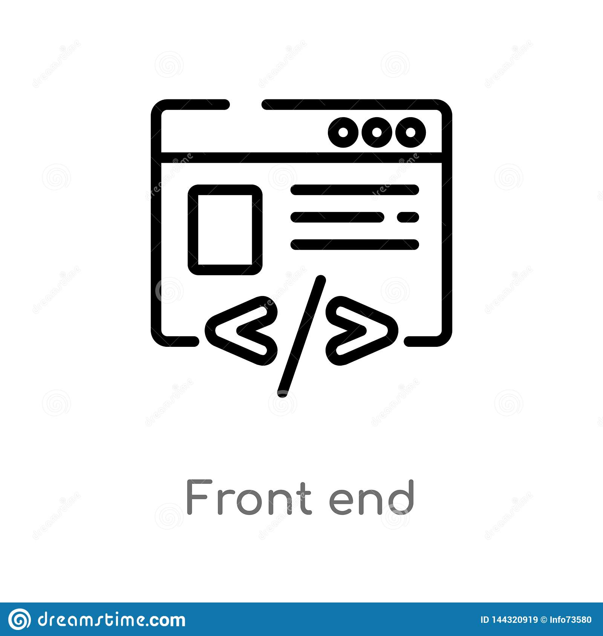





admin>node .
admin>
How to do Web Development?
Web Development can be split into two domains, specifically Frontend web development and Backend Web Development.
Frontend involves, HTML, CSS, JS, frameworks and libraries. They help in designing and structuring a website from the user perspective, how the user will interact with it and how appealing it will look.

Slide 7





admin>node .
admin>
How to do Web Development?
Backend involves, Nodejs, Express, Django, DBMS(Database Management Systems) and others. They help you manage requests that a user makes and how the website should respond accordingly.
The process of doing both is called full stack web development and a person who can do both is called a full stack web developer. There are various stacks that can be used, such as MERN, MEAN and others.

Slide 8
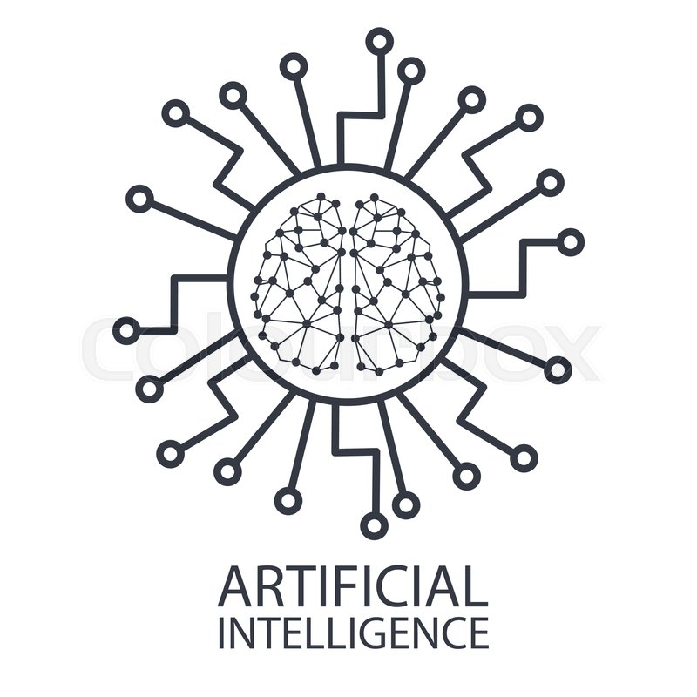
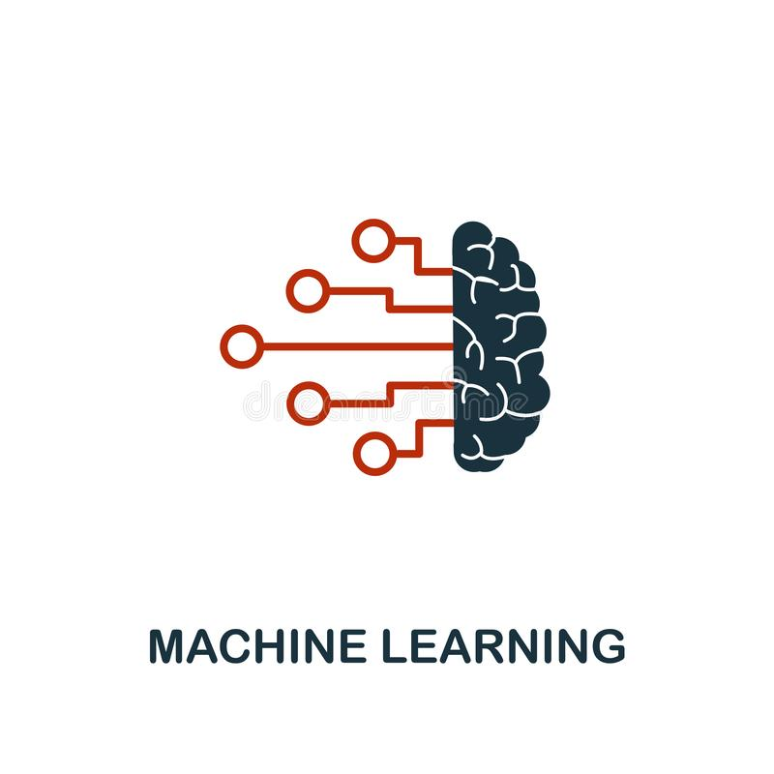
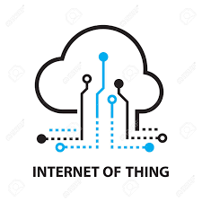
admin>node .
admin>
Future Aspects of Web Development.
The future of web development is nowhere in the dark, as every industry segment requires a website to take its product or services online. It’s driven by technology and will continue to do so to a greater extent in the coming years. Some main components that well make development in the future even more interesting are,

Slide 9
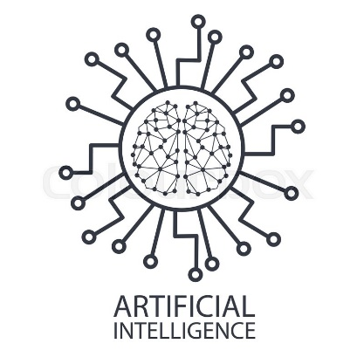
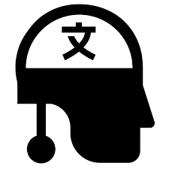

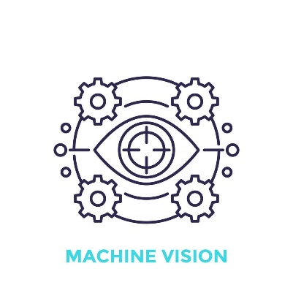
admin>node .
admin>
Future Aspects of Web Development. Artificial Intelligence.
AI is the simulation of human intelligence or even mimicking it by processess of machine, and computer systems.
Some examples are natural languages processing, speech recognition and machine vision.
It works on the foundation of machine learning algorithms.
They take in large stream of data, analyze it for correlations and patterns, and use them to make the most human like prediction of the future state.

Slide 10

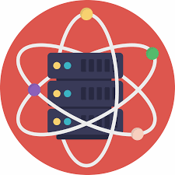
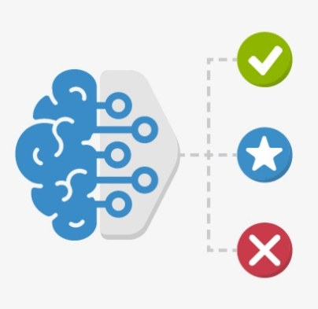
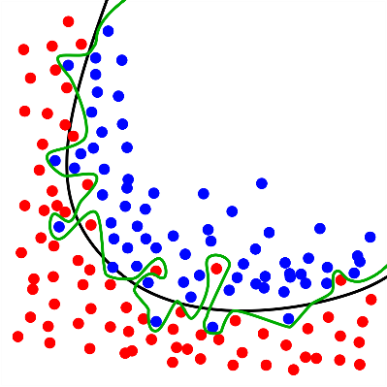
admin>node .
admin>
Future Aspects of Web Development. Machine Learning.
ML is a branch of Artificial Intelligence.
The process of taking in data, using algorithms to eliminate the human intervention and make predictions for what might happen in the future, based on patterns and correlations is what ML is all about.

Slide 11
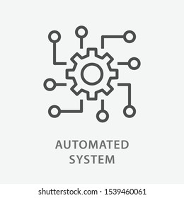
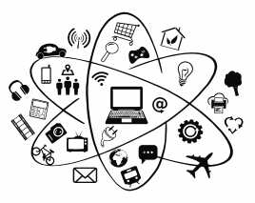

admin>node .
admin>
Future Aspects of Web Development. Internet of Things.
The IoT describes the network of physical objects– “Things” – that are embedded with sensors, software, and other technologies for the purpose of connecting and exchanging data with other devices and systems over the internet.
While IoT and Web Dev have their own nuances. Being able to make websites and web applications that have the ability to interact with technology give any web dev an upper hand.

Slide 12
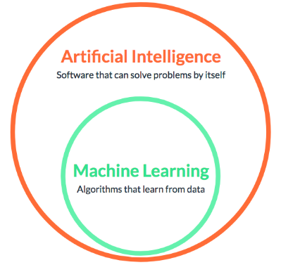
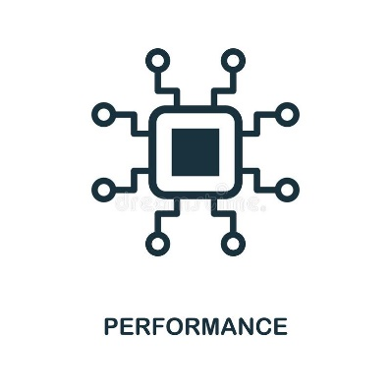
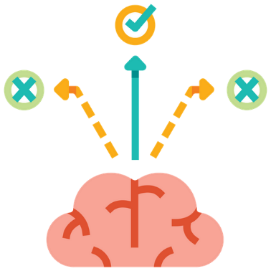

admin>node .
admin>
Differences- AI vs ML and IoT.
AI works as a computer program, ML is a simple concept machine that takes data and learns from it.
AI’s goal is to simulate natural intelligence and solve complex problem, ML’s goal is to learn from data on certain task and maximize the performance of the machine.
AI is decision making, ML allows systems to learn new things from data.
AI leads to intelligence and wisdom, ML leads to knowledge.

Slide 13


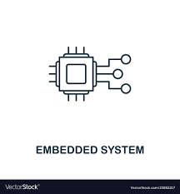
admin>node .
admin>
Differences- AI vs ML and IoT.
IoT however requires a person to not only learn the aspects of web development but also adapt to the convergence of multiple technologies, real-time analytics, including ML, ubiquitous computing, wireless sensors, control systems, automation, embedded systems and such.

Slide 14

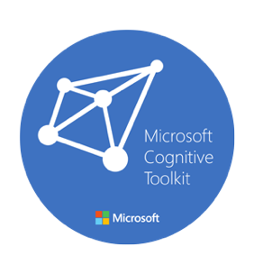


admin>node .
admin>
How can they be applied to Web Development?
AI and ML are popular technologies that allow web applications to learn and observe from a user’s preferences and habits. After making assumptions and analyzing the data, possible future sets can be used to optimize websites.
Frameworks are best to be used by web devs to help them implement in their own field. Some popular frameworks are, TensorFlow, Apache Mahou and Singa, Microsoft Cognitive Toolkit and more.

Slide 15
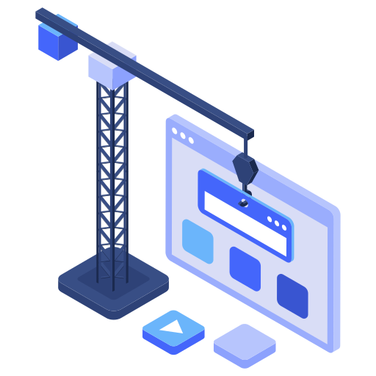
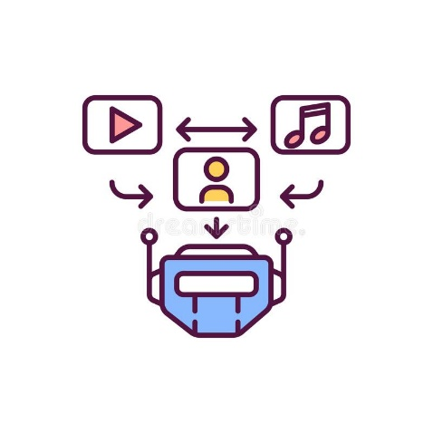
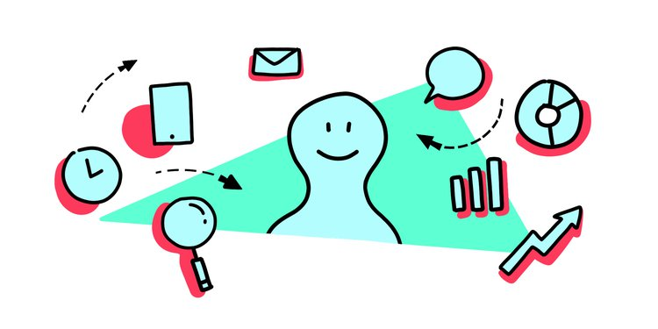
admin>node .
admin>
Possible Outcomes and Conclusion.
Helping to construct a website without starting from the very scratch.
Analyzing up the content and user preferences to personalize the site and make it easy for the users.
Assistance.

Slide 16
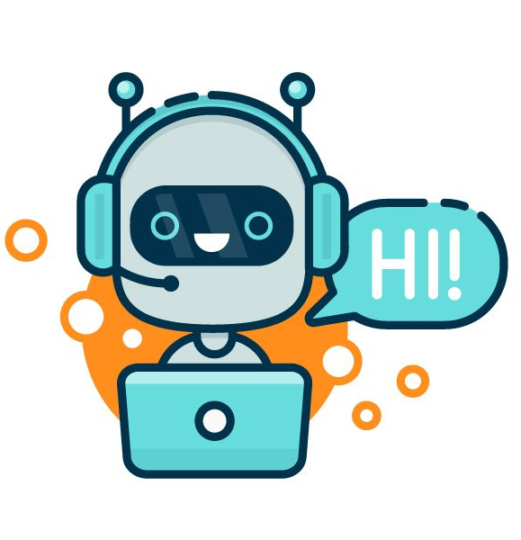
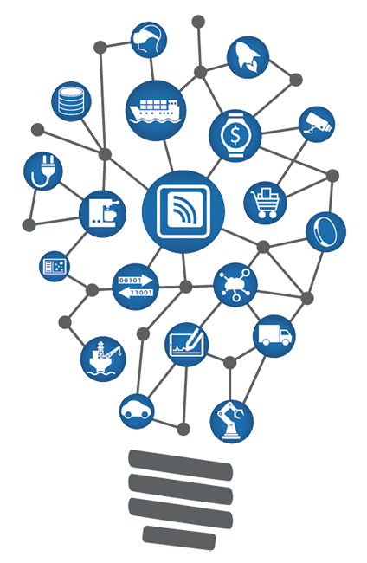

admin>node .
admin>
Possible Outcomes and Conclusion.
Enabling an average technology knowledge user to manage their website without any problems or issues.
Chatbots for immediate user interaction.
Ability to connect everyday objects, kitchen appliances, cars, thermostats, etc for seamless communication between people, processes and things.

Slide 17
admin>node .
admin>
THANK
YOU

